Slide 1
Introduction to SEO

Slide 2
SEO
SEO can be defined as an aggregate of all the work necessary to produce a high volume of referral hits from search engines, web directories, and other websites, with the ultimate goal of making the website popular.
SEO involves internal and external website analysis, including link building, proper website architecture and development, competitor analysis, keyword research, content development, and many other tasks.
SEO is partly about building appropriate content and partly about getting people to link to you.

Slide 3
Search engine marketing (SEM) and SEO
SEM is carried out through PPC (pay-per-click )
PPC advertising is much easier to implement and can achieve immediate results.
Marketers will often ignore (or confuse) SEO in favor of (PPC) SEM.
But by doing so they are ignoring great opportunities.
SEO is about as close to free as you can get.
It takes work, and work costs money, particularly if you hire a consultant. But have any advertising bills coming in

Slide 4
SEO
SEO gets the visitor to the door. It is up to your site’s content to welcome and retain that visitor.
Optimizing just for search engines may not be enough. Social media websites along with social bookmarking should be considered as well.

Slide 5
The SEO Process
The SEO process can be broken down into six general phases.
Research
Planning and strategy
Implementation,
monitoring,
(re)assessment, and
maintenance.

Slide 6
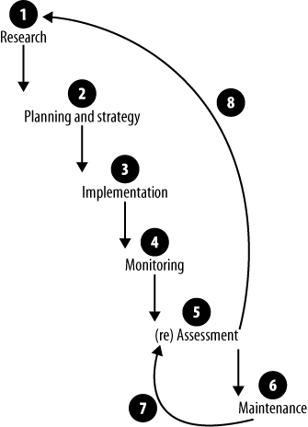
The SEO Process

Slide 7
The Research Phase
The research phase is the first phase of the SEO process.
It usually consists of several different types of research, including
business research,
competitor analysis,
Current state assessment, and
keyword research.

Slide 8
The Research Phase
Business research
Analysis of business in relation to its online presence.
What does your company have that the competition does not?
What is your selling point?
When it comes to your online marketing ask yourself:
How much do you understand about SEO and PPC?
Are you looking to target certain demographics or geographical locations?
What are your general and specific expectations?
How do you measure success?
What do you perceive as failure?
What is your budget?
Do you have resources available to handle SEO and/or SEM?
Who is the owner (driver) of your SEO efforts?
What does the project schedule look like? Are there specific timelines?

Slide 9
The Research Phase
Competitor analysis
Learn about all the players in your business area.
Understand where they are now and how they got there.
Find out who is linking to them. Explore how much content their site contains.
See how many pages they have indexed in Google and other search engines.
Estimate their website traffic and investigate what keywords they are targeting.
In general, the more you know about your competitors, the better. This book talks about a number of tools you can use to analyze your site and your competitors’ sites.

Slide 10
The Research Phase
Current state assessment
Tasked is increasing the visibility of an existing site.
Dig deep into the site, dissecting it from all angles.
In SEO vocabulary, this is labeled as the site clinic.
This research process is very similar to competitor analysis, only this time your focus is solely on the site you are assigned to work with.
Check the current site rankings (if any).
Start examining the internal (on-page and on-site) factors, including site age, <title> tags, <meta> tags, internal linking structures, content duplication, search engine traps, and so forth.

Slide 11
The Research Phase
Current state assessment
In parallel, you also look at the external factors. How many backlinks does this site have? Who is linking to this site?
Inquire about current technology being used, current practices, the availability of any in-house technical expertise, web server logs, web analytics, and so on.
Resource availability and budget need to be defined.

Slide 12
The Research Phase
Keyword research
Keyword research is the activity of identifying and targeting specific keywords with the goal of creating relevant search engine referrals.
Keyword research does not apply only to on-page textual elements.
It also applies to domain name selection, inbound links, link composition, directory listings, and many other elements.
The basic question is always:
what keywords do I target?
Do you target the most popular (broad) keywords? Or do you target the niche (narrow) keywords?

Slide 13
The Research Phase
Output of the research phase
Is the SEO research artifact or document summarizing the findings of the research phase.
This document should contain all of your findings, including the business research, competitor analysis, current state assessment, and keyword research.

Slide 14
The Planning and Strategy Phase
Several strategies are developed including
handling content,
link building,
social media, and SEM, as well as
technical strategies.
All of these strategies can be rolled up into a single artifact: the SEO plan.

Slide 15
The Planning and Strategy Phase
Content strategy
Your content strategy needs to address all aspects of content: creation, modification, dissemination, and archival.
It also needs to address the area of content presentation:
how will this content be presented to end users?
whether the site will include blogs, press releases, testimonials, syndication, media files, and similar items.
Which content needs to be crawled (and indexed) and which does not need to be in the search engine index.

Slide 16
The Planning and Strategy Phase
Link-building strategy
you must have solid inbound links. Content with no links can go only so far.
Include planning regarding whether you are going after
(paid or free) directory submissions,
social media sites,
social bookmarking,
Blog comments,
direct solicitation,
news syndication, or
press releases

Slide 17
The Planning and Strategy Phase
Social media strategy
You can consider this strategy as an important extension of the overall linkbuilding strategy.
Engaging your clients on social media sites can be helpful and rewarding if done properly.

Slide 18
The Planning and Strategy Phase
Search engine targeting strategy
A search engine targeting strategy can mean several things.
What search engines will you be targeting?
This includes targeting regional as well as major search engines.

Slide 19
The Planning and Strategy Phase
SEM strategy
Using PPC in parallel with SEO can be helpful, especially if the site in question is brand new.
PPC can provide accurate forecasts for targeted keywords.
For example, within the Google AdWords platform you can target the same keywords in your ads that you are currently targeting on specific pages.

Slide 20
The Planning and Strategy Phase
Technical strategy
Basic SEO technical elements like
URL rewriting,
avoiding content duplication (canonicalization),
error messaging, and
linking structures.
Some other technical elements are
what tools and platforms are required to build the site?
Will you be developing custom software? If yes, understanding the underlying software architecture is important. Also need to make architectural provisions to allow for proper SEO.

Slide 21
The Planning and Strategy Phase
Technical strategy
It also includes many decisions like
What browsers will need to be supported?
Do any hosting considerations need to be taken into account?
Your technical strategy also needs to include provisions for monitoring, reporting, and analyzing SEO progress.

Slide 22
The Planning and Strategy Phase
Output of the planning and strategy phase
The output is the SEO plan.
The SEO plan contains information on internal and external proposed optimizations.
This includes on-page and off-page optimizations as derived from particular strategies.
The SEO plan is also a road map.
It documents the steps and activities that are required to get better rankings for a particular site.

Slide 23
The Planning and Strategy Phase
Output of the planning and strategy phase
It also documents steps and procedures that will need to be followed for the addition or modification of any new content, after the SEO plan is implemented.
The SEO plan should be revised every few months, as search engines and your rankings never stand still.

Slide 24
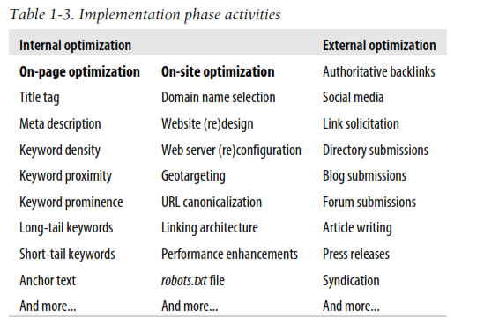
The Implementation Phase

Slide 25
The Implementation Phase
Internal optimization
Internal optimization refers to on-page and on-site activities.
On-page activities include keyword optimizations of <title> tags, description meta tags, page copy, and link
anchor text.
On-site optimization refers to holistic sitewide activities. Domain selection (in the case of new sites), website design or redesign, web server configuration, and sitewide performance tuning are all part of on-site optimization activities.

Slide 26
The Implementation Phase
External optimization
The major goal of all external optimization activities centers on link building.
It is all about your site’s visibility.
Each link referral can be viewed as a vote for your site.
The more quality links you have, the more popular your site will be.

Slide 27
The Implementation Phase
Output of the implementation phase
The output of the implementation phase can be several artifacts detailing any new technical knowledge gained, problems encountered, and lessons learned.
Furthermore, any deviations from the original SEO plan should be documented with appropriate rationale noted.
Procedures and processes for adding new content or making website changes (e.g., backups, maintenance, and deployment) should also be formalized.

Slide 28
The Monitoring Phase
The monitoring phase comprises just that: monitoring.
You need to monitor several things like
web spider activities,
referral sites,
search engine rankings,
Website traffic,
conversions,
hacker intrusions, and more.

Slide 29
The Monitoring Phase
Output of the monitoring phase
The output of the monitoring phase is sets of data, typically organized in monthly report summaries.
This usually includes data from web stats tools and web analytics tools.
This output serves as the input to the (re)assessment phase.

Slide 30
The Assessment Phase
The assessment phase uses the output of the monitoring phase as well as a series of
checklists (on which to base the assessment). T
his phase is also referred to as the checkpoint phase.
SEO checkpoints can be defined on a monthly, quarterly, semiannual, or yearly basis.
At the very least, quarterly assessments are required.
The point of the assessment phase is to see what is and isn’t working according to the
SEO plan.
Output of the assessment phase
The output of the assessment phase is the recommendation artifact. At times, this could be a call to action for further research or a call to action for further minor tweaks.

Slide 31
The Maintenance Phase
The maintenance phase takes care of problems (minor and major) found in the (re)assessment phase.
Output of the maintenance phase
The output of the maintenance phase is a confirmation of all the SEO work performed, in addition to any problems encountered and any lessons learned.

Slide 32
SEO Benefits
Search engine results page (SERP) real estate
historical trust factor, and
lower cost of ownership.

Slide 33
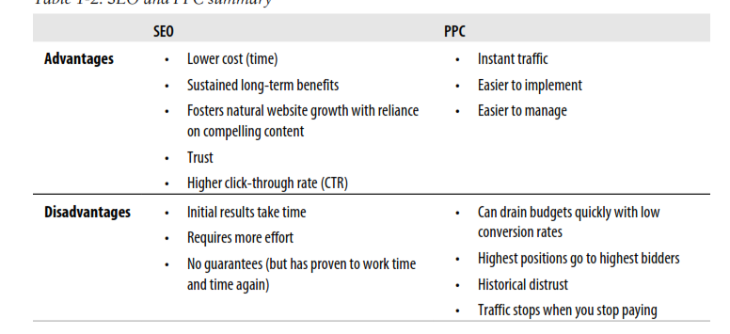
SEO Vs PPC

Slide 34
SEO Challenges
Competition
No guarantees
Ranking fluctuations
time factors and
organization structure.

Slide 35
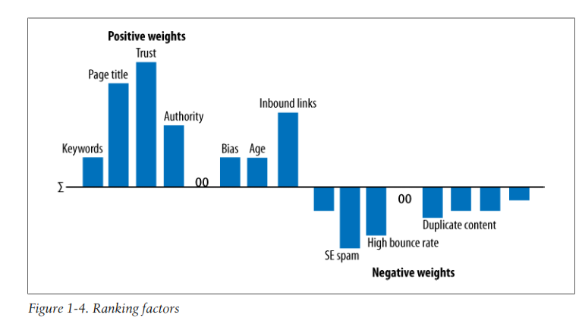

Slide 36
Analyzing Ranking Factors: Main
Page Level Link Metrics
Domain Level Link Authority Features
Page Level Keyword Usage
Domain Level Keyword Usage
Page Level Social Metrics
Domain Level Brand Metrics
Page Level Keyword Agnostic Features
Page Level Traffic/Query Data
Domain Level Keyword Agnostic Features

Slide 37
Analyzing Ranking Factors: Other
Rate of acquisition of links
User data
Google sandbox

Slide 38
Analyzing Ranking Factors :Negative
Malware being hosted on the site
Cloaking
Pages on the site that sell links
Content that advertises paid links on the site

